Slide 1
Practice 10.
Yoon-Yeong Kim
Dept. of Statistics, UOS
yykim@uos.ac.kr

Slide 2
Short Recap

Slide 3
Basic Structure: Singly Linked List
Construct a singly linked list with nodes and references.
A node consists of :
A variable to hold a reference to its next node
A variable to hold a reference to its value object
Special nodes: Head and Tail
You can construct the singly linked list without them.
But, using them makes search, insert and delete more convenient.
Generally, requires more coding than array.
Object
N e x t
Object
N e x t
Object
N e x t
Object
N e x t
Head
Tail
‘a’
‘b’

Slide 4
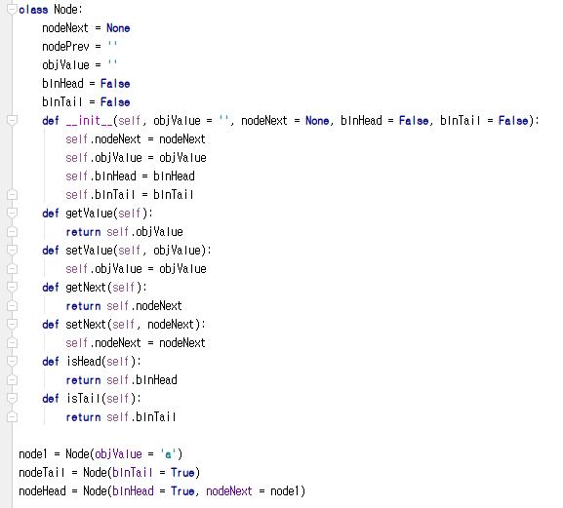
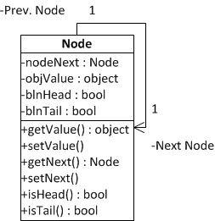
Implementation of Node Class
Member variables (Attribute)
Variable to reference the next node
Variable to hold a value object
(Optional) Variable to check whether it is a head or not
(Optional) Variable to check whether it is a tail or not
Member functions (Method)
Various set/get methods

Slide 5
Search Procedure in Singly Linked List
Again, let’s find ‘d’ and ‘c’ from the list.
Just like an array, navigating from the first to the last until hit is the only way.
No difference in the search pattern, though you cannot use index any further.
Instead, we can use nodeNext to move to the next element.
Your list implementation may include the index function, but it is not required in the linked list
node.objValue == ‘c’ → False: No hit!
node.objValue == ‘c’ → False: No hit!
node.objValue == ‘c’ → False: No hit!
node.objValue == ‘c’ → False: No hit!
node.objValue == ‘c’ → False: No hit!
head
‘a’
‘b’
‘d’
‘e’
‘f’
tail
node.objValue == ‘d’ → False: No hit!
node.objValue == ‘d’ → False: No hit!
node.objValue == ‘d’ → True: Hit!
After five retrievals,
we found that there will be no hit! (always N retrievals)
After three retrievals, we found the hit! (maximum N retrievals)

Slide 6
Insert Procedure in Singly Linked List
This is the moment that you see the power of a linked list.
This time, you need only three operations. (Last time needed N retrievals.)
Assume you have a reference to the node, Node_{prev}, that you want to put your new node next.
First, you store a Node, or a Node_{next}, pointed by a reference from Node_{prev}’s nodeNext member variable.
Second, you change a reference from Node_{prev}’s nodeNext to Node_{new.}
Third, you change a reference from Node_{new}’s nodeNext to Node_{next.}
Node_{new}
‘c’
(3) Add this reference
(2) Update this reference
(1) Store this node
head
‘a’
‘b’
‘d’
‘e’
‘f’
tail
Node_{prev}
Node_{next}
Over-written with a new reference to the new node

Slide 7
Delete Procedure in Singly Linked List
This is the another moment that you see the power of a linked list.
This time, you need only three operations. (Last time needed N-1 retrievals.)
With an assumption that you have a reference to the node, Node_{prev} that you want to remove the node next.
First, you retrieve Node_{next} that is two steps next from Node_{prev.}
Second, you change a reference from Node_{prev}’s nodeNext to Node_{next.}
The node will be removed because there is no reference to Node_{remove.}
(2) Update this reference
(1) Retrieve this node that is two step next
head
‘a’
‘b’
‘c’
‘d’
‘e’
‘f’
tail
Node_{prev}
Node_{remove}
Node_{next}
Over-written with a new reference to the next node of the removed one

Slide 8
Structure of Stack
Top Only Accessible
Stacks are linear like linked lists.
A variation of a singly linked list.
Difference
Voluntarily giving up an access to the middle in the linked list
Only accesses to the first instance in the list.
The first instance in the list = The top instance in the stack
An item is inserted or removed from the stack from one end called the “top” of the stack.
This mechanism is called Last-In-First-Out (LIFO).
Cargo Object 1
Cargo Object 2
Cargo Object 3
Cargo Object 4
Cargo Object 5
Cargo Object 6

Slide 9
Structure of Queue
Queues are linear like linked lists
A variation of a singly linked list
Difference
Voluntarily giving up an access to the middle in the linked list == Same to the stacks
Only accesses to the first and the last instances in the list
The first instance in the list = The front instance in the queue
The last instance in the list = The rear instance in the queue
An item is inserted at the last
An item is removed at the front
This mechanism is called First-In-First-Out (FIFO)
Product 1
Product 2
Product 3
Product 4

Slide 10
Production Line Model (Continued)

Slide 11
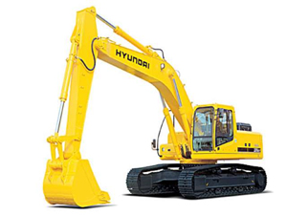
Production Planning Management
Excavator producers in Korea
Hyundai, Doosan…
Excavators are pretty expensive
Start production when orders come in
Any problem?
Orders always change
Cancelling
Changing the delivery date
Changing the specification
Changes get more difficult to handle when they are aggregated for a month-long production list
How to store and manage the production data?

Slide 12
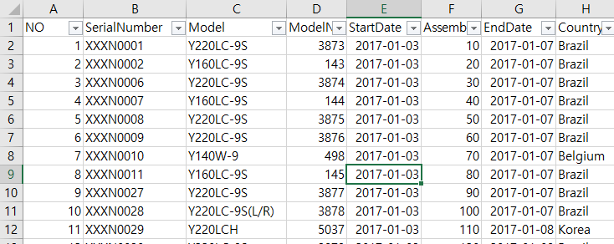
Dataset
You are given four production plans of excavator production.
Plan on Dec 17, 2012
This week, we are going to use only this data.
Plan on Dec 24, 2012
Plan on Jan 10, 2013
Plan on Jan 11, 2013
Four columns
No: just a number on the row
Serial Number: Unique identifier of an order
Model: Model name of the excavator
Model Number: The unique number of the product in the model line
Start Date: Production start date
Assembly Order: Production order
End Date: Production end date
Country: Order origination

Slide 13
Manufacturing Execution System
Processor 1
Processor 2
Processor 3
Planned Product
Finished Product
Processor 4
Processor 5
Processor 6
Processors have their own list of products to handle.
Processor 1,2,3 follows the stack.
Processor 4,5,6 follows the queue.
Problem 1. Complete the production list class.
Code addFirst, removeLast, removeFirst, and getSize & Code setNextNode and setPrevNode.
Problem 2. Complete the stack class.
Problem 3. Complete the queue class.
Problem 4. Complete the arriveProduct method of ManufacturingProcess class.
Given “plan” should be added to the method of either stack or queue.

Slide 14
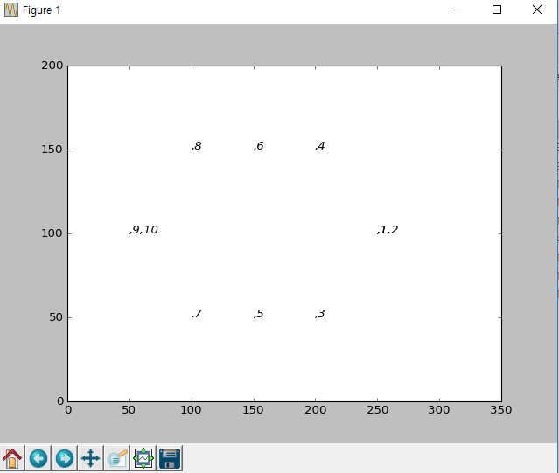
Expected Result
When you complete the codes, you are expected to see the below results.
Execute ‘run.py’

